Slide 1

Introduction to Machine Learning
János Botzheim
Head of the Department of Artificial Intelligence

Slide 2





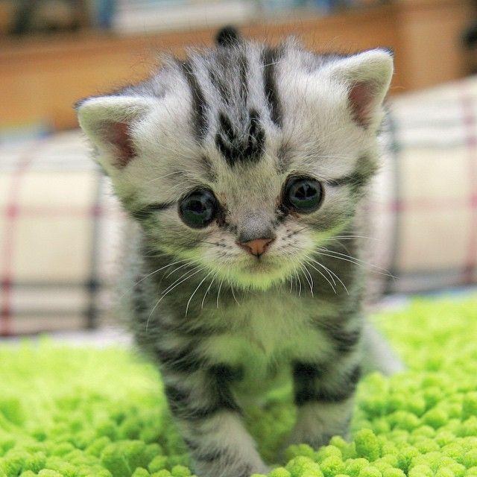
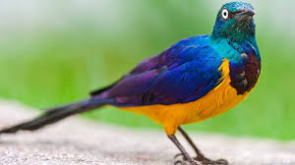
Unsupervised learning

Slide 3
Supervised learning
label
dog
cat
bird

Slide 4
Learning - Programming
Traditional computer programming:
Supervised learning:
Unsupervised learning:
Input
Computer
Output
Program
Input
Computer
Program
Output
Computer
Program
Input
Output

Slide 5
Types of learning
Learning
Agent can improve its performance based on observations
Machine Learning
Subset of artificial intelligence, computer system learns by patterns in observation data
Learning tasks
Classification: output is one of a finite set of values
Regression: output is a numeric prediction
Learning Feedback
Supervised Learning – learn a function that maps inputs to outputs by observing input-output pairs
Unsupervised Learning – learn patterns in data without explicit feedback (e.g., clustering)
Reinforcement Learning – learn beneficial actions based on rewards and punishments

Slide 6
Supervised Learning

Slide 7
Supervised learning
given: input-output training patterns (x1^{(p)}, x2^{(p)},…, xn^{(p)}, d^{(p)})
p: number of patterns, n-dimensional input, scalar output
x
d
system
+
+
error
y
-
model

Slide 8
Supervised learning
Representation:
rule based system
fuzzy system
decision tree
neural network
support vector machine
etc.
Evaluation:
error
accuracy
cost
entropy
etc.
Optimization:
gradient based algorithm
evolutionary algorithm
etc.

Slide 9
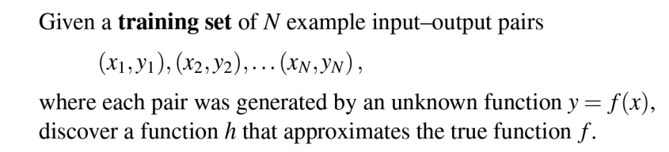
Supervised Learning
More formally
The function h is called a hypothesis or a model of the data

Slide 10
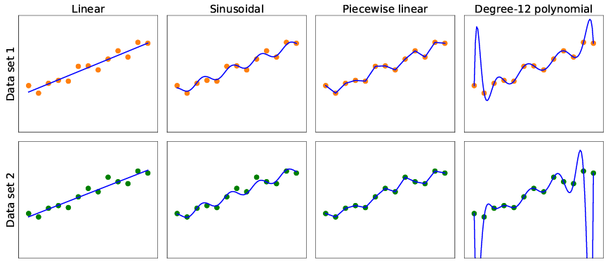
Supervised Learning

Slide 11
Supervised Learning - Generalization
Performance measures
Performance on the training set
Performance on test set
Generalization
h generalizes well if it accurately predicts the outputs of the test set

Slide 12
Supervised Learning - Bias & Variance
One way to analyze hypothesis spaces is by the bias they impose (regardless of the training data set) and the variance they produce (from one training set to another).
Bias
The tendency of a predictive hypothesis to deviate from the expected value when averaged over different training sets
Variance
The amount of change in the hypothesis due to fluctuation in the training data
Bias–variance tradeoff
more complex, low-bias hypotheses that fit the training data well
simpler, low-variance hypotheses that may generalize better

Slide 13
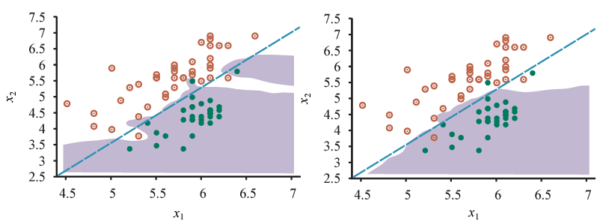
Supervised Learning - Underfitting & Overfitting
Underfitting
The algorithm fails to find a pattern in the data
Model is too simple
Overfitting
Fits too much to the particular data set it is trained on
Performs poorly on unseen data (train-test accuracy)
Model is too complex
Amount of data is not enough
Data is not diverse enough

Slide 14


Decision Trees
Maps a vector of attribute values to a single output “decision”
Sequence of tests
Start from root
Explore branches
Until a leaf is reached
Node = test of input attribute value
Input and output values can be discrete or continuous
Simple example: Boolean decision tree
A Boolean decision tree is equivalent to a logical statement of the form:
Where are attribute-value tests corresponding to a path from the root to a true leaf

Slide 15
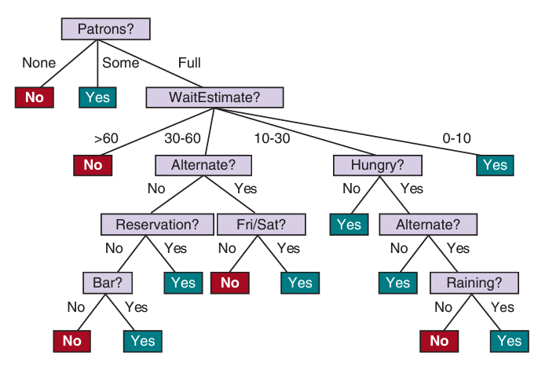
Decision Trees
Example: Waiting in restaurant

Slide 16
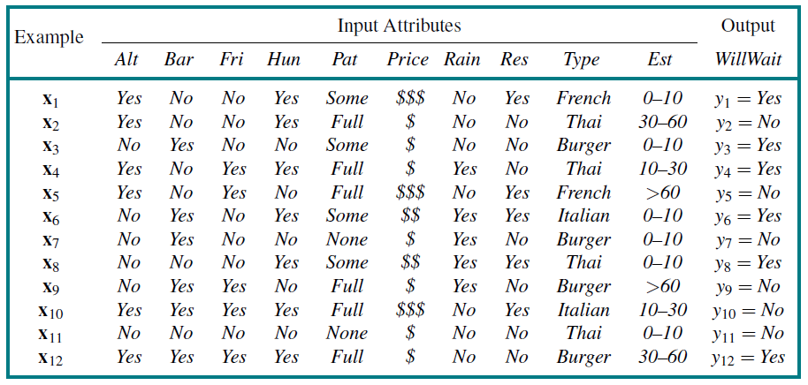
Decision Trees
Training dataset

Slide 17
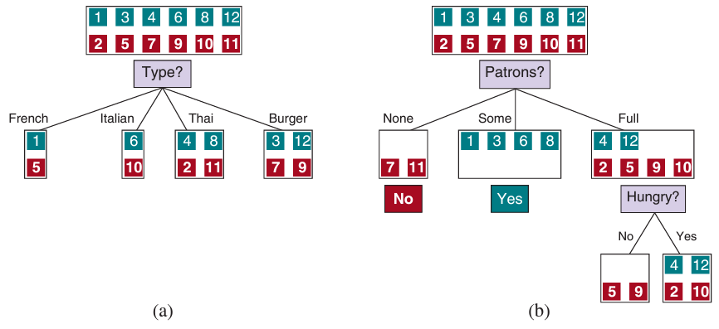
Decision Trees
Find most important features and solve sub-problems sequentially

Slide 18
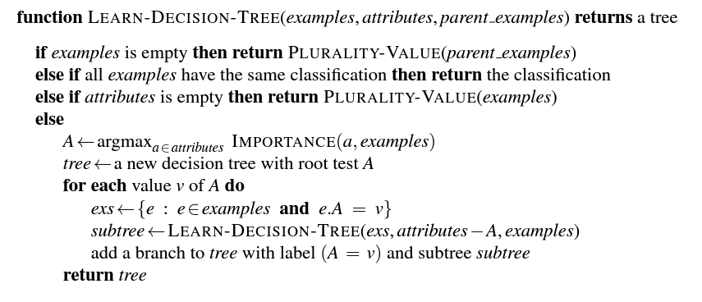
Decision Trees

Slide 19
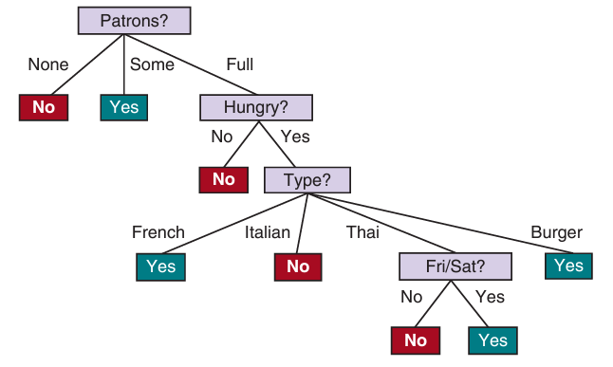
Decision Trees
Final decision tree has short paths
Simpler than the original tree
Fitted to the training set
BUT The learning algorithm looks at the examples, not at the correct function
Selecting most important attributes based on information gain defined by expected reduction in entropy of the output variable

Slide 20
Decision Trees
Generalization
If we increase the number of attributes, overfitting is more likely
If we increase the number of training samples, overfitting is less likely
Pruning: improving generalization for decision trees
Eliminate nodes that are not clearly relevant
Look at a test node that has only leaf nodes as descendants
If the test appears to be irrelevant - eliminate and replace it with a leaf node
Use significance test to measure low information gain threshold

Slide 21
Decision Trees
Pros
Ease of understanding
Scalability to large data sets
Versatility in handling discrete and continuous inputs
Performing classification and regression
Cons
Suboptimal accuracy (largely due to the greedy search)
If trees are very deep, then getting a prediction for a new example can be expensive
Decision trees are unstable – adding just one new example can change the entire tree

Slide 22


Linear Regression and Classification
Univariate Linear Regression = “fitting a straight line” fit model on (x, y) training examples so that y = w₁x + w₀ where w₀ and w₁ are learned weights
The learned linear function
The task of finding this linear function based on training data is called linear regression
Find values of w₀, w₁ that minimizes the empirical loss (e.g., L₂ loss)

Slide 23

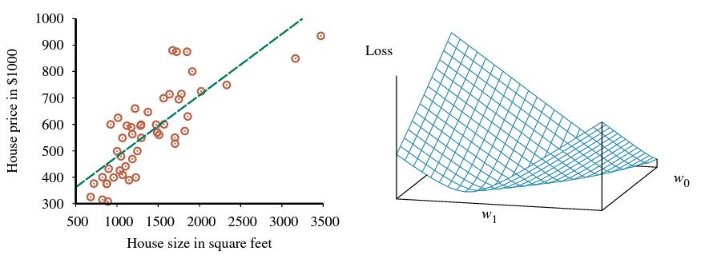
Linear Regression and Classification
We can find the function that minimizes the loss using partial derivatives

Slide 24
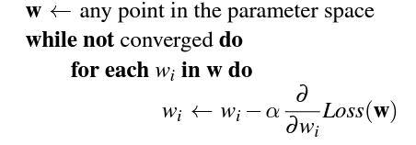
Linear Regression and Classification
For more complex cases we need to introduce gradient descent
Algorithm for finding a point in the weight space that minimizes the loss
Similar to the hill climbing but here we are minimizing the loss, not maximizing the gain
Gradient Descent
Select random starting point in weight space
Compute an estimate of the gradient
Move a small amount in the steepest downhill direction
Repeat until we converge on a point with minimum loss
Parameters
Learning rate (α) – determines the step size for the descent

Slide 25
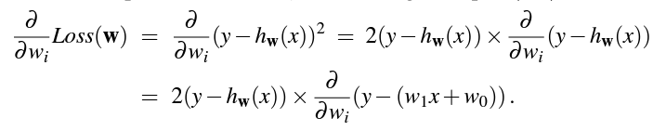
Linear Regression and Classification
For the univariate case the loss was quadratic - the partial derivative is linear
We apply the chain rule
Create the update function with the selected learning rate
Single example
Batch

Slide 26
Linear Regression and Classification
Batch
A set of training examples, size of the batch is a parameter
Epoch
A pass through all training examples in the training dataset
Batch Gradient Descent
Calculate gradients and update weights for a whole batch of training examples
Stochastic Gradient Descent
Randomly selects a small number of training examples at each step, performs batch updates
Linear Regression for Classification

Slide 27
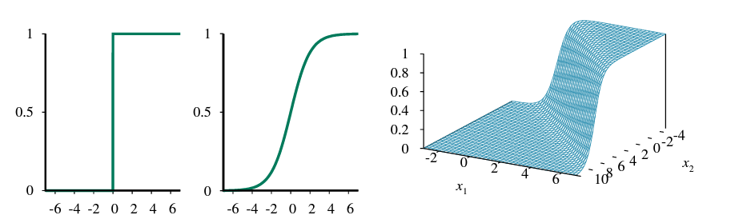

Linear Classification with Logistic Regression
Threshold Problems with classification using linear regression
Function makes hypothesis discontinuous function of its inputs and weights
No confidence values are reported (either 1 or 0)
Solution: approximate hard threshold with a continuous and differentiable function
The logistic or sigmoid function

Slide 28
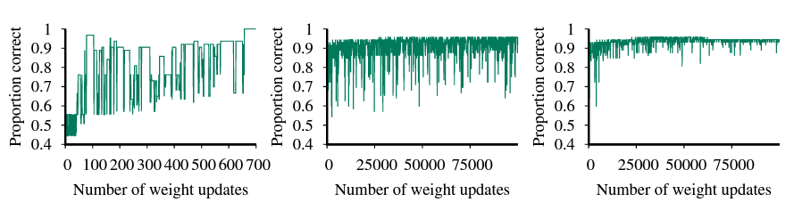
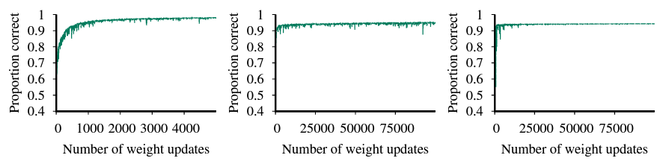
Linear Classification with Logistic Regression
Solution: approximate hard threshold with a continuous and differentiable function
The logistic or sigmoid function

Slide 29
K-Nearest Neighbors
Parametric vs. non-parametric
Parametric
Uses training data to estimate a set of parameters that define the hypothesis
Information in training data is summarized in the weights of the trained model
Non-Parametric:
Can not be described by a fixed set of parameters
Retains training data as part of the model
Simple example: Table Lookup

Slide 30
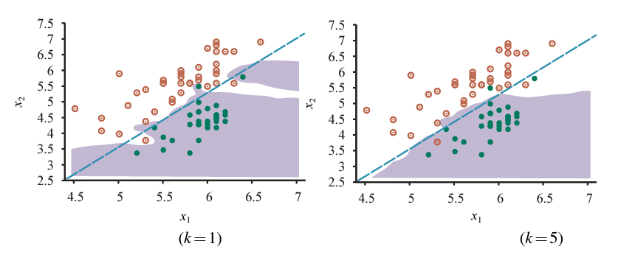
K-Nearest Neighbors
Goal: Find the k examples that are nearest to x_{q} queried example and return the most common output value of the neighborhood
Find a set of neighbors based on a distance metric

Slide 31
K-Nearest Neighbors
Overfitting and underfitting with K-nearest neighbors

Slide 32
K-Nearest Neighbors
Goal: Find the k examples that are nearest to x_{q} queried example and return the most common output value of the neighborhood
Find a set of neighbors based on a distance metric
Distance Metrics
Minkowski distance
Measures the distance between two points in N-dimensional space (generalization of Euclidean and Manhattan distance)
Hamming distance
Measures the distance between Boolean vectors
Mahalanobis distance
Measures the distance between a point and a distribution based on covariances

Slide 33
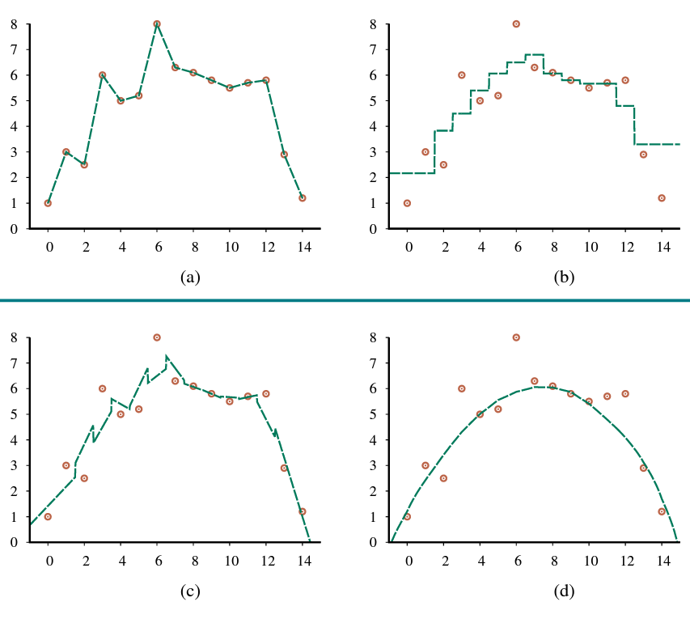

K-Nearest Neighbors
K-nearest neighbors regression (non-parametric regression)
Take the k-nearest-neighbors average as output value
i.e., h(x) is the mean value of the k points
With larger k values the line will be smoother

Slide 34
Unsupervised Learning

Slide 35
Unsupervised learning
Labeled data (data whose classification is known) are sometimes not available
Sometimes not even the classes and their characteristic features are known
Clusters are data groups in which the points have small distances/high similarity, where the different clusters have a large distance/low similarity

Slide 36
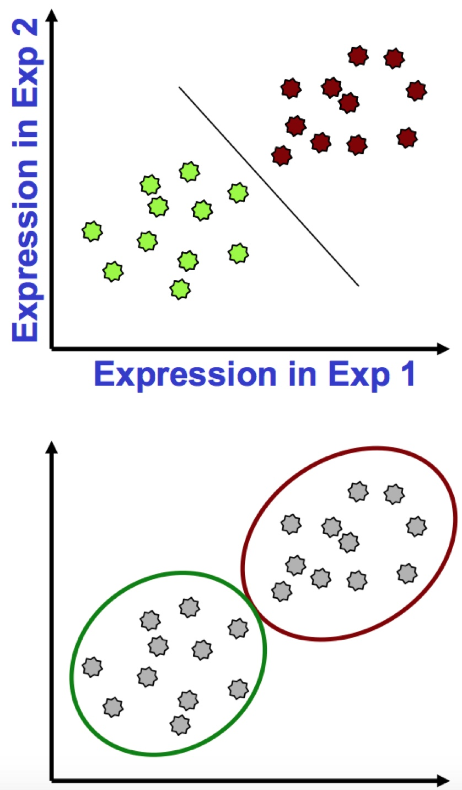
Clustering vs. classification
Objects are characterized by one or more features
Classification
Points have labels
Want a “rule” that will accurately assign labels to new points
Supervised learning
Clustering
No labels
Group points into clusters based on how “near” they are to one another
Identify structure in the data
Unsupervised learning

Slide 37
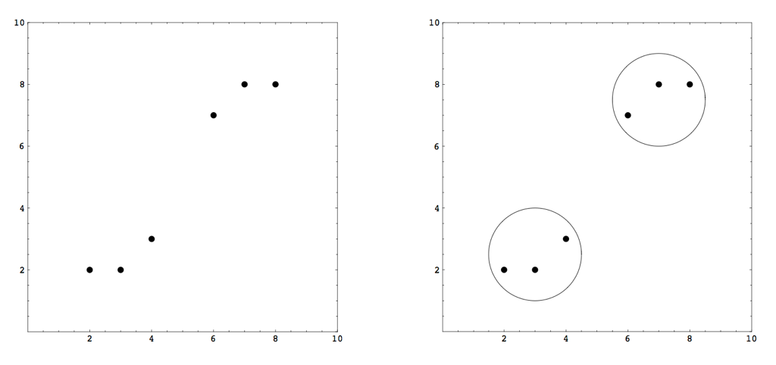
What is a cluster?
A group of data in which the elements are very similar/close to each other, while the data in different clusters are significantly different/distant from each other.

Slide 38
Reasons for the usage
Labelled (classified) data are not always available
Sometimes even classes or characteristic properties are not known
Reducing the number of data

Slide 39
Few application
Signal and image decomposition
Data analysis
Market analysis (identification of target customer groups)
Content management (grouping similar documents)
Fuzzy rule extraction
...

Slide 40
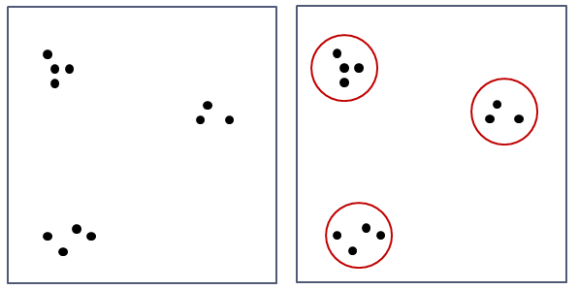
A simple example
We want to build the rule base from a dataset
The data set must first be clustered
Simple example:

Slide 41
Basic requirements
We have n data samples in p-dimensional space
$\left(i=1, …, n\right):$
$x_{i} ∈ X_{1}× … ×X_{p}$
So, all the data are:
$X=\left\{x_{1},…,x_{n}\right\}$
The goal is to define a subset system $C_{1},C_{2},…,C_{k} ⊆X$ where: $C_{i} ≠\text{∅} ∀ i$
$C_{1}∪ … ∪C_{k}=X$
$C_{i}∩C_{j}=\text{∅}$ $∀ i≠j$

Slide 42
Agglomerative clustering
We start with the most rigorous clustering, i.e. n single-element clusters
Then we iteratively merge the two closest clusters
We continue until we have only one cluster with all the data elements
We do not create a partition, but a sequence of partitions
We do not need to specify the number of clusters in advance
Most of these methods are slow and only work on small data sets

Slide 43
SAHN Clustering
Sequential Agglomerative Hierarchical Non-overlapping Clustering
Given: $\left\{x_{1},…,x_{n}\right\}⊆R^{p}$ and d distance metrics
Initially: $K_{0}=n, Γ_{0}=\left\{C_{0,1},…, C_{0,k_{0}}\right\}=\left\{\left\{x_{1}\right\},…,\left\{x_{n}\right\}\right\}$
For $i=0, …, n−1$ we look for the $\left(a,b\right)$ pair, for which $d\left(C_{i,a},C_{i,b}\right)$ is minimal.
$Γ_{i+1}=\left(Γ_{i} \backslash \left\{C_{i,a},C_{i,b}\right\}\right)∪\left\{C_{i,a}∪C_{i,b}\right\}$
Output: $Γ_{0},…,Γ_{n−1}$

Slide 44
SAHN distance metrics
Minimum
$d\left(C_{a},C_{b}\right)= \min_{xεC_{a}, yεC_{b}}\left\|x−y\right\|$
Maximum
$d\left(C_{a},C_{b}\right)= \max_{xεC_{a}, yεC_{b}}\left\|x−y\right\|$
Average
$d\left(C_{a},C_{b}\right)=\frac{1}{\left|C_{a}\right|∙\left|C_{b}\right|} \underset{x∈C_{a},y∈C_{b}}{\sum{\left\|x−y\right\|}}$

Slide 45
Prototype based clustering
Not all individual data are kept in clusters
Rather, in each 𝐶_{𝑖} cluster, we designate a point 𝑣_{𝑖} in the data space, usually called the cluster center
Each data point belongs to that cluster whose center point is the closest to the data
So: $x_{k} ∈ C_{i}$ if

Slide 46
Partition matrix
Which cluster each data point belongs to
$U=\left(\begin{matrix}u_{11} & ⋯ & u_{1n} \\ ⋮ & ⋱ & ⋮ \\ u_{K1} & ⋯ & u_{Kn}\end{matrix}\right)$ $u_{ik}=\left\{\begin{matrix}1 if x_{k}∈C_{i} \\ 0 otherwise\end{matrix}\right.$
All data are elements of a cluster:
There is no empty cluster:

Slide 47
k-means clustering
Iterative process for clustering
Minimize the following function
Calculating the centroids
(1)

Slide 48
k-means clustering
Input: a data set $\left\{x_{1},...,x_{n}\right\}⊆R^{p}$, ‖.‖ is a norm defined on $Rp$ , K is the predefined number of clusters, 𝑡_max is the maximum number of iterations, ${\left\|.\right\|}_{v}$is a distance measure, 𝜀 is the tolerance
Initialization: $V^{\left(0\right)}⊆R^{p}$
For ${t=0, …, t}_{max}$
Determine the partition matrix $U^{\left(t\right)}\left(V^{\left(t−1\right)}\right)$
Determine the cluster centroids $V^{\left(t\right)}\left(U^{\left(t\right)}\right)$ (from equation (1))
If ${\left\|V^{\left(t\right)}−V^{\left(t−1\right)}\right\|}_{v}≤ε$ ,end
Result:
The partition matrix U and the cluster centers V

Slide 49
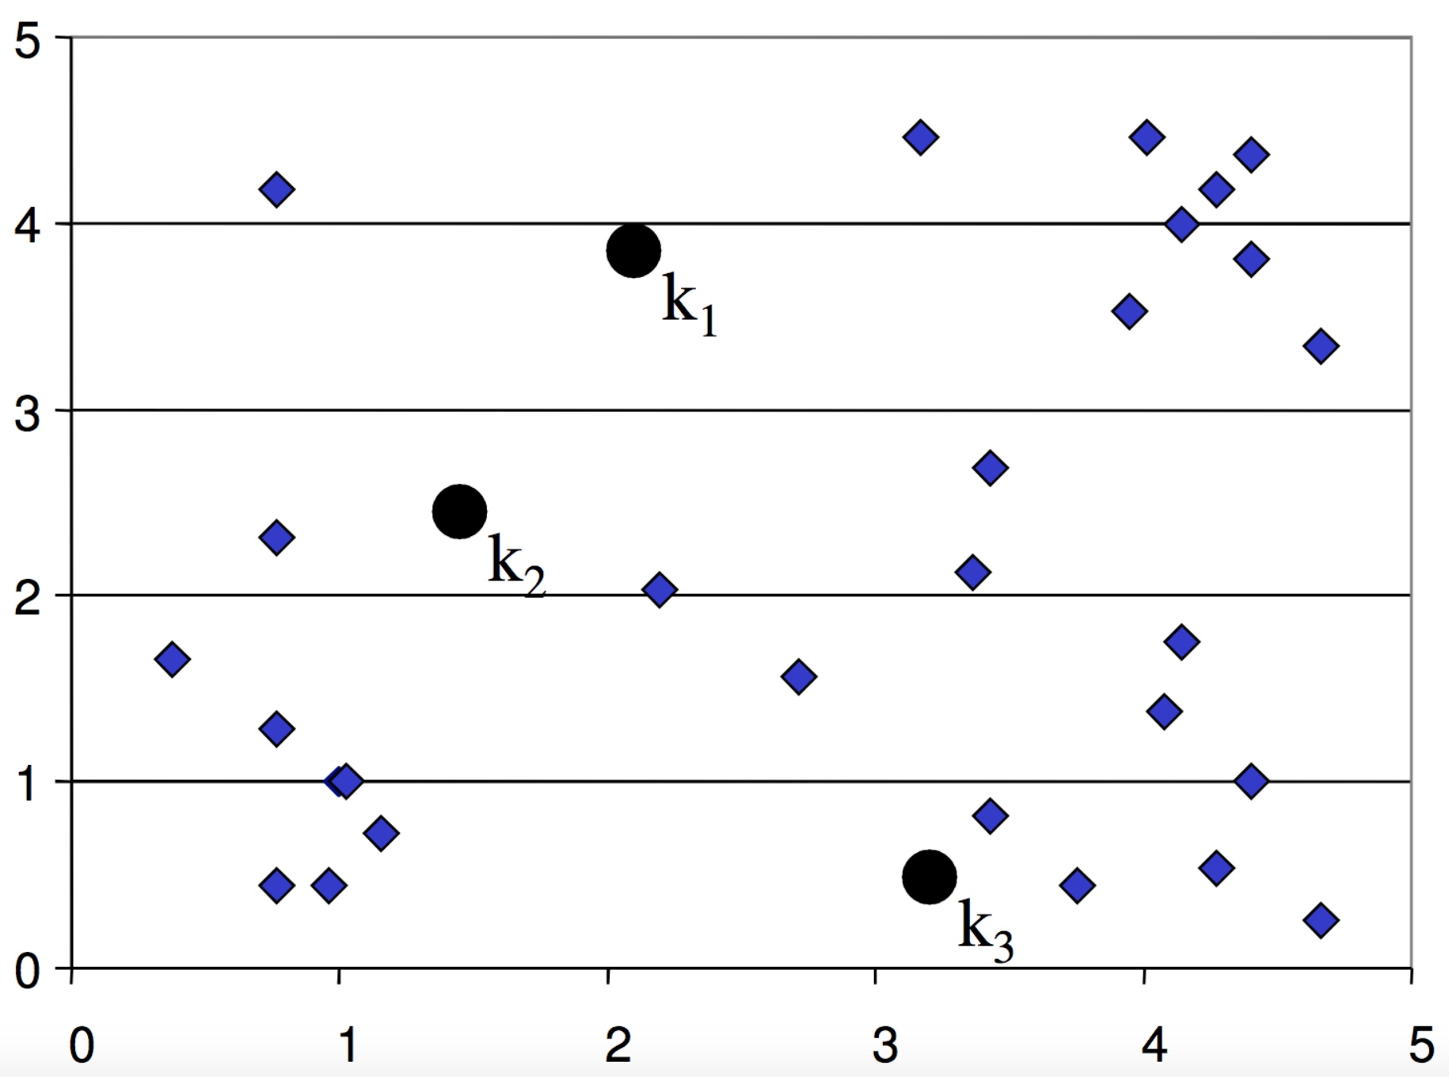
k-means clustering
Initialization:
decide K
initialize K cluster centers randomly

Slide 50
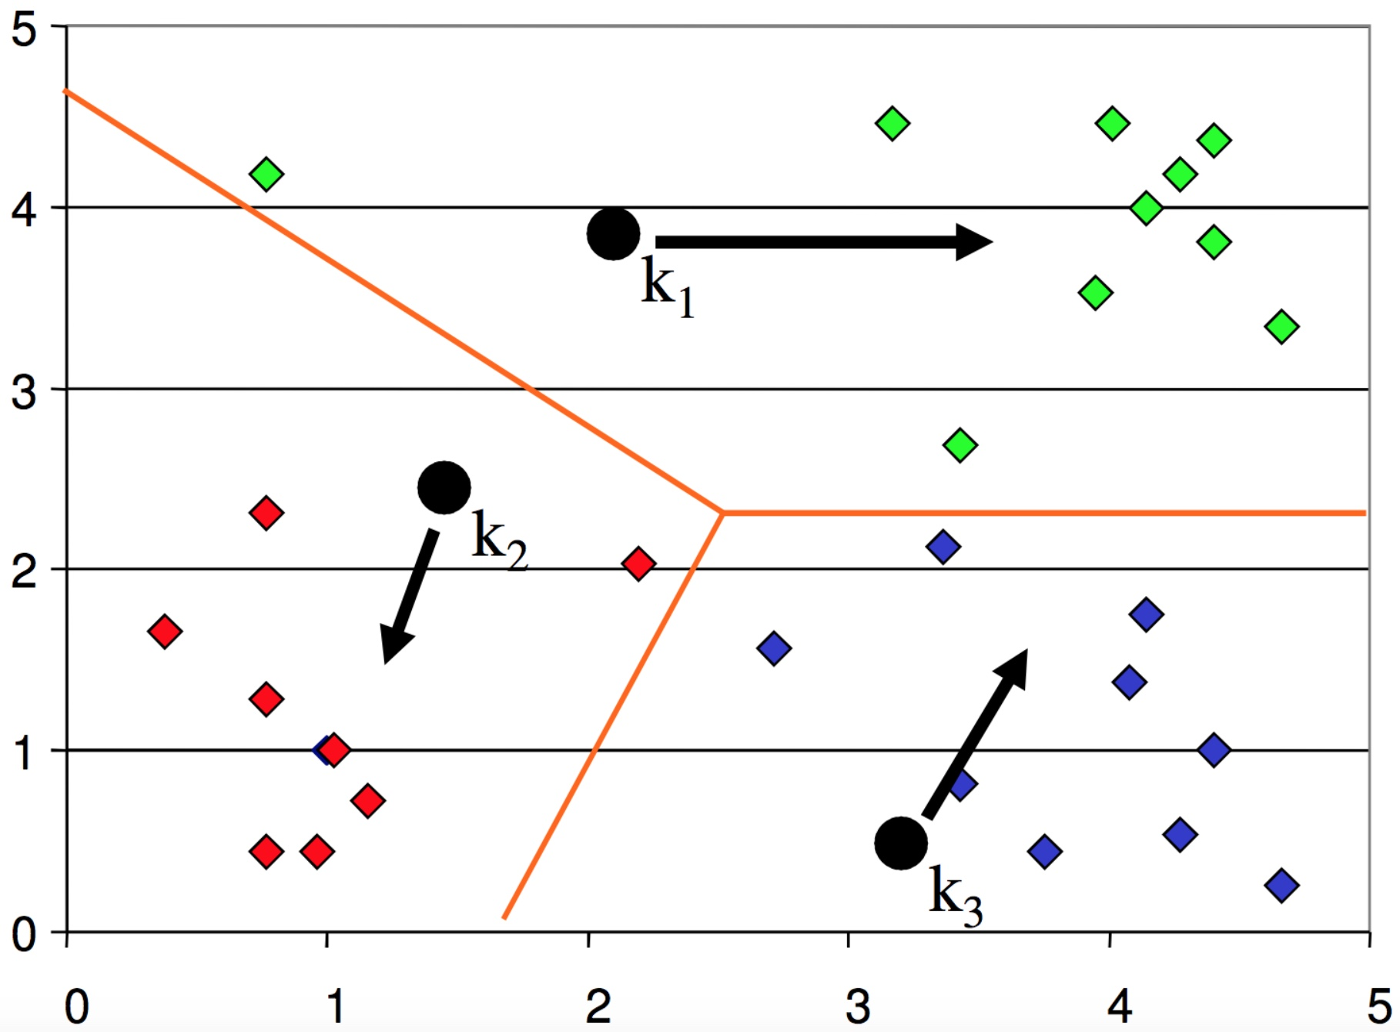
k-means clustering
Iteration:
assign all points to the nearest cluster center
move the centers to the mean of their members

Slide 51
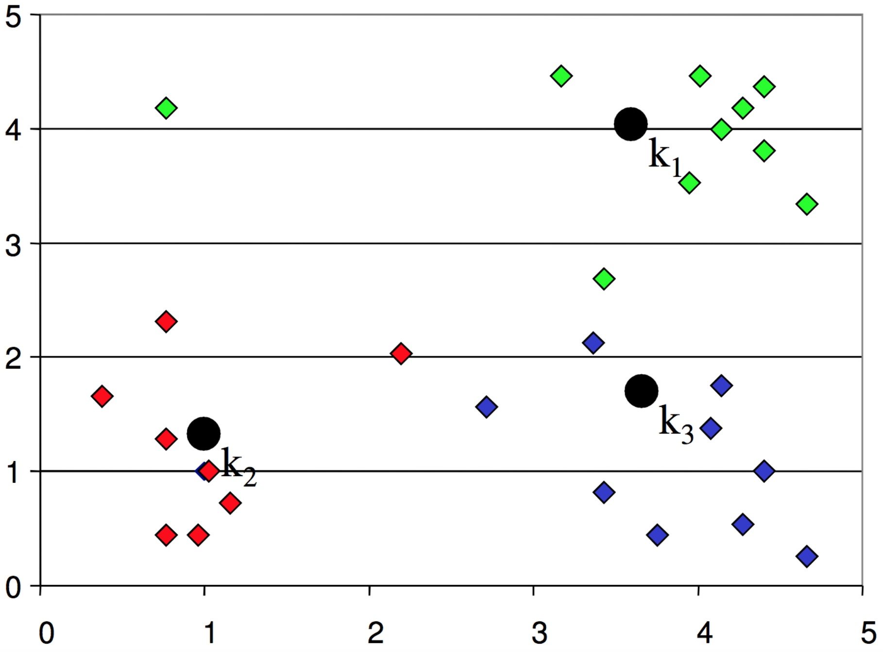
k-means clustering
Iteration:
after moving centers, re-assign the points to the nearest center

Slide 52
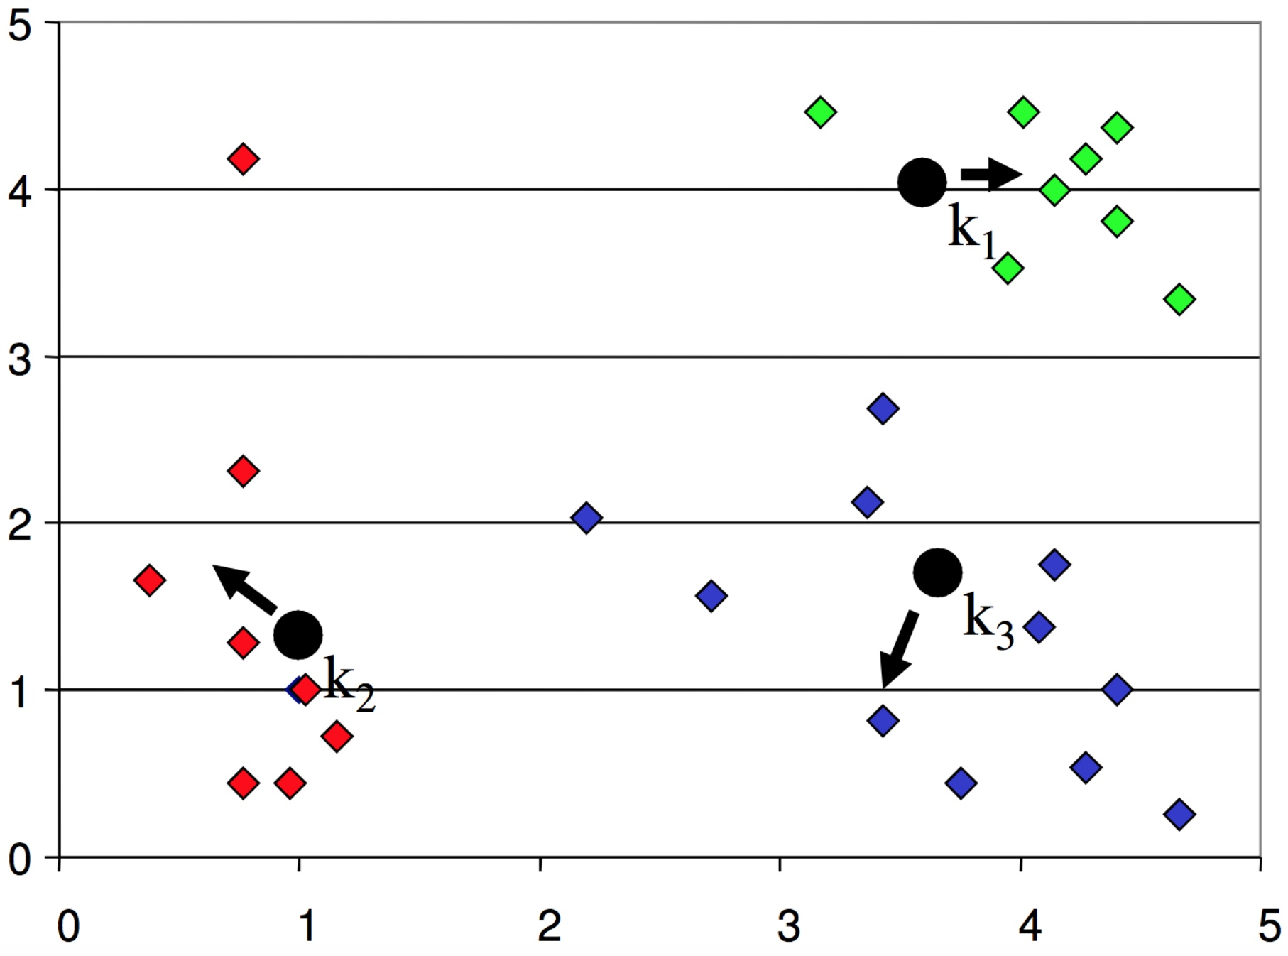
k-means clustering
Iteration:
move the centers to the mean of their members

Slide 53
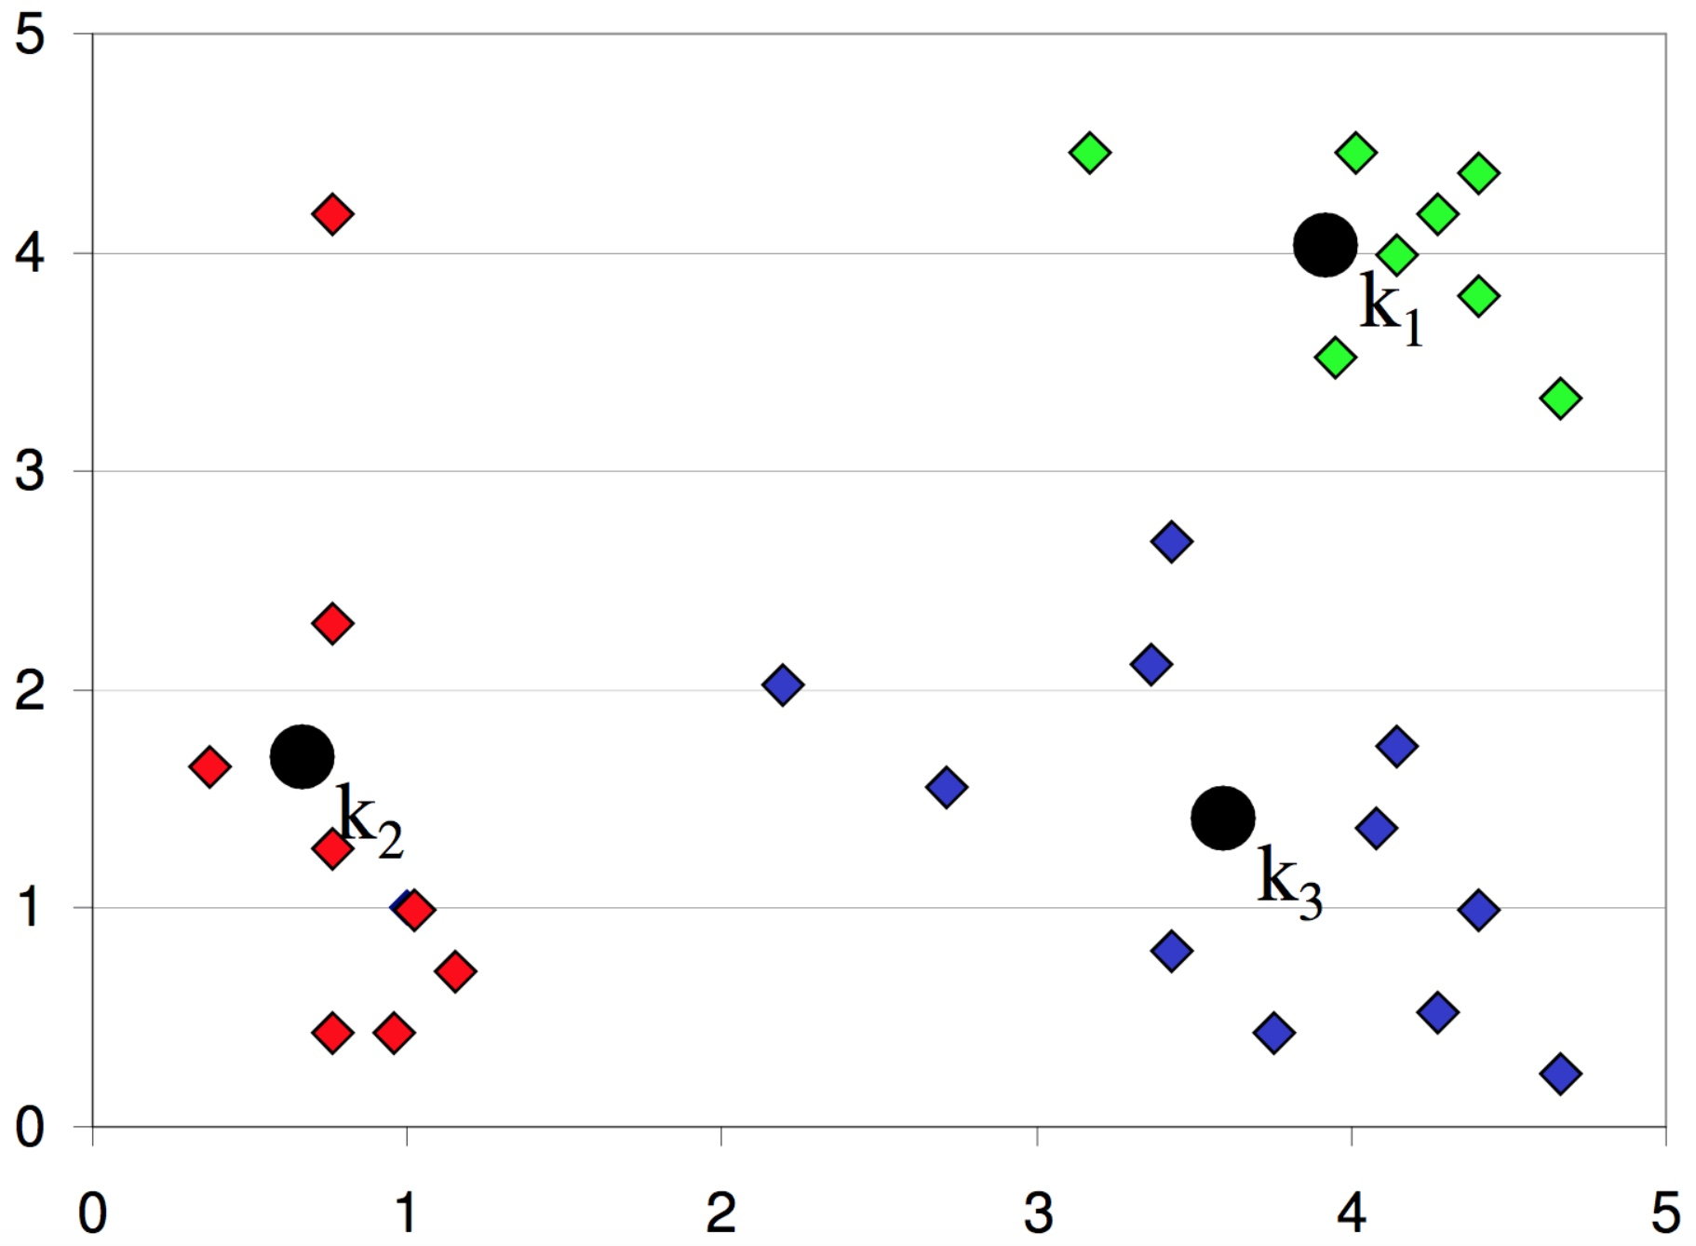
k-means clustering
Finished:
re-assign and move centers, until no points changed membership

Slide 54
k-means clustering
1. Decide the value of K, the number of clusters
2. Initialize the K cluster centers randomly
3. Decide the class membership of the N points by assigning them to the nearest cluster center
4. Re-estimate the K cluster centers, by assuming the memberships found above are correct
5. Repeat 3 and 4 until none of the N points changed membership in the last iteration

Slide 55
k-means clustering
Strength:
Simple, easy to implement
Intuitive objective function: optimizes intra-cluster similarity
Relatively efficient: O(t⋅k⋅n), where n: number of points (data), k: number of clusters, t: number of iterations, usually: k,t<<n
Weakness:
Applicable only when mean is defined
Often terminates at a local optimum. Initialization is important
Need to specify K, the number of clusters, in advance
Unable to handle noisy data and outliers
Not suitable to discover clusters with non-convex shapes

Slide 56
How to define the right number of clusters?

Slide 57
How to define the right number of clusters?

Slide 58
How to define the right number of clusters?

Slide 59
How to define the right number of clusters?

Slide 60
How to define the right number of clusters?

